Slide 1


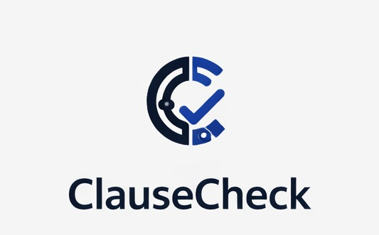
-AI Assisted Contract Intelligence
A decision-support system for legal professionals to analyze contracts faster, safer, and more consistently.
Team: Pallavi Nagasamudram, Guna Vardhan Byraju, Yashwanth Seeram

Slide 2
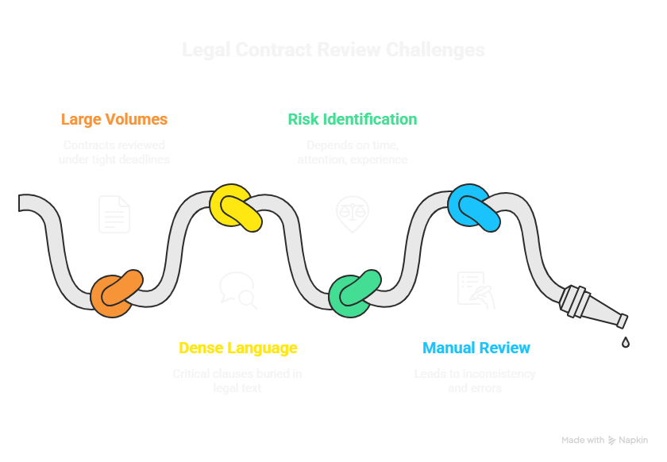
The Problem

Slide 3
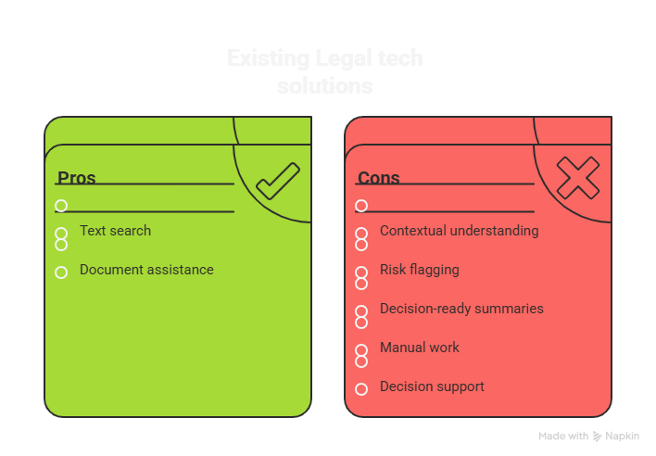
Why Existing Solutions Fail?

Slide 4
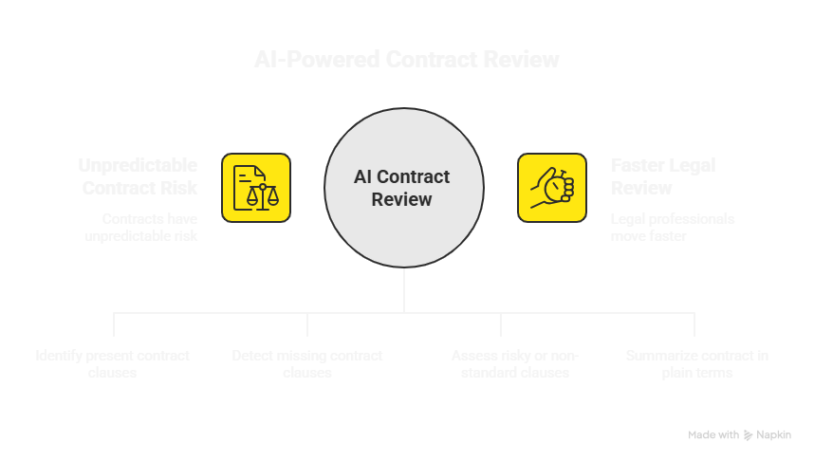
Our Solution

Slide 5
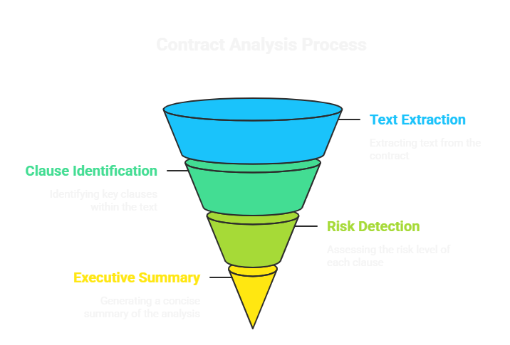
How this works?

Slide 6
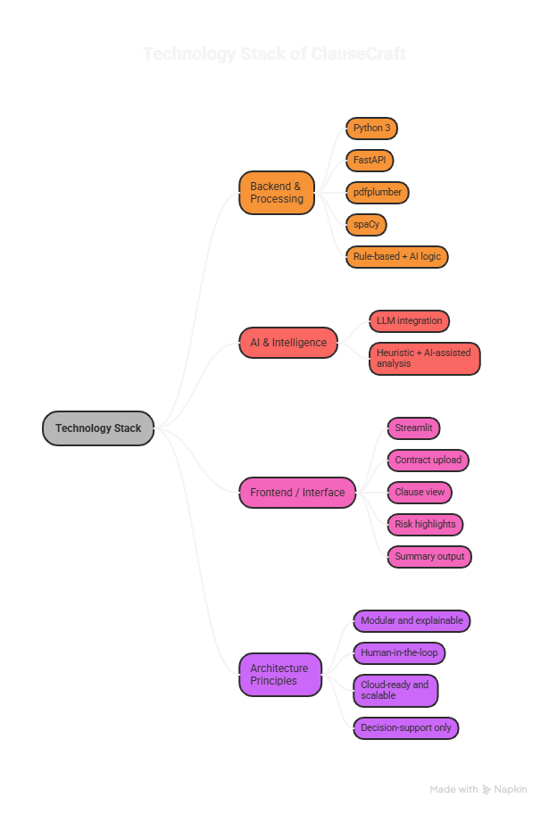

Slide 7
DEMO

Slide 8
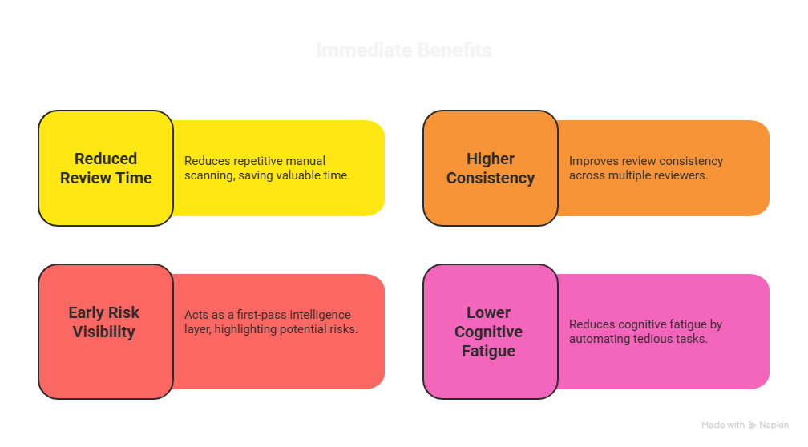
Why this is Valuable?

Slide 9
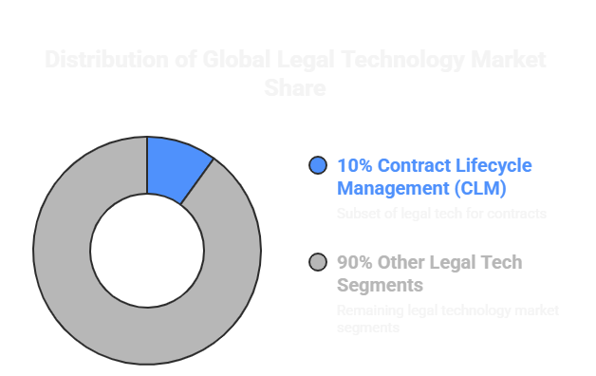
Market Opportunity

Slide 10
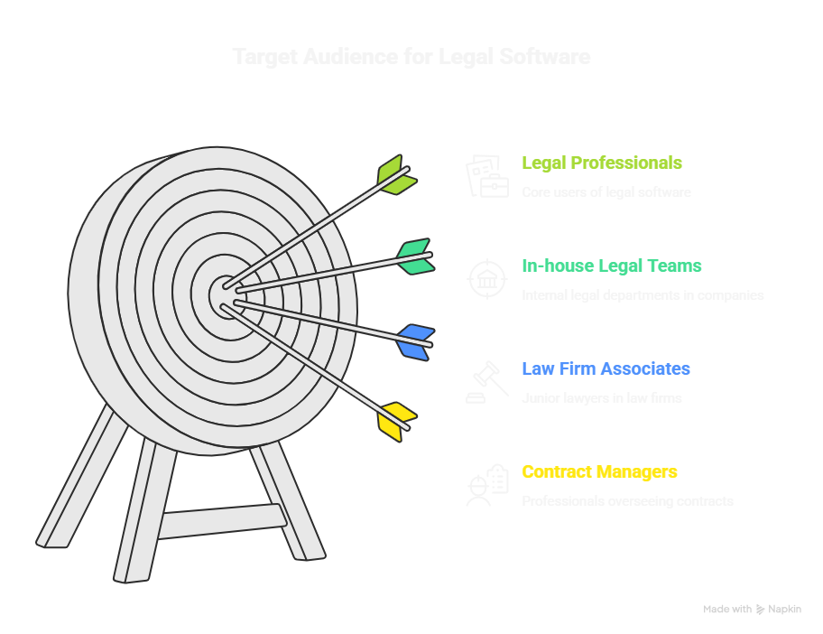

Slide 11
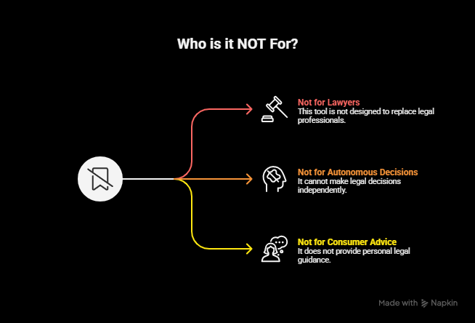

Slide 12
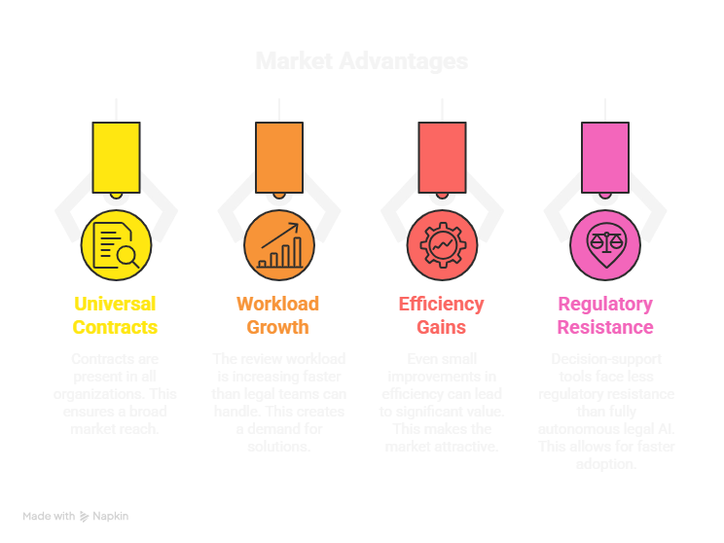

Slide 13
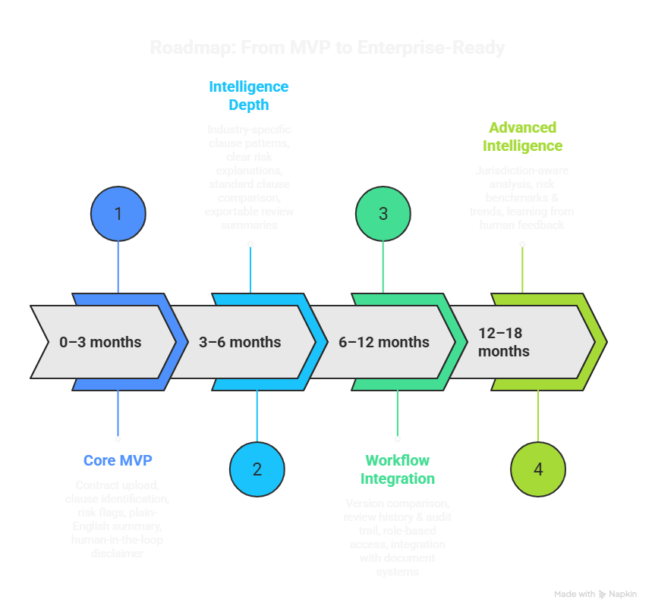

Slide 14
ClauseCraft is not just a contract tool. It is the foundation for how legal professionals interact with contracts - faster, safer, and more consistently.

Slide 15
Thank You

